Slide 1
Environment setup

Slide 2
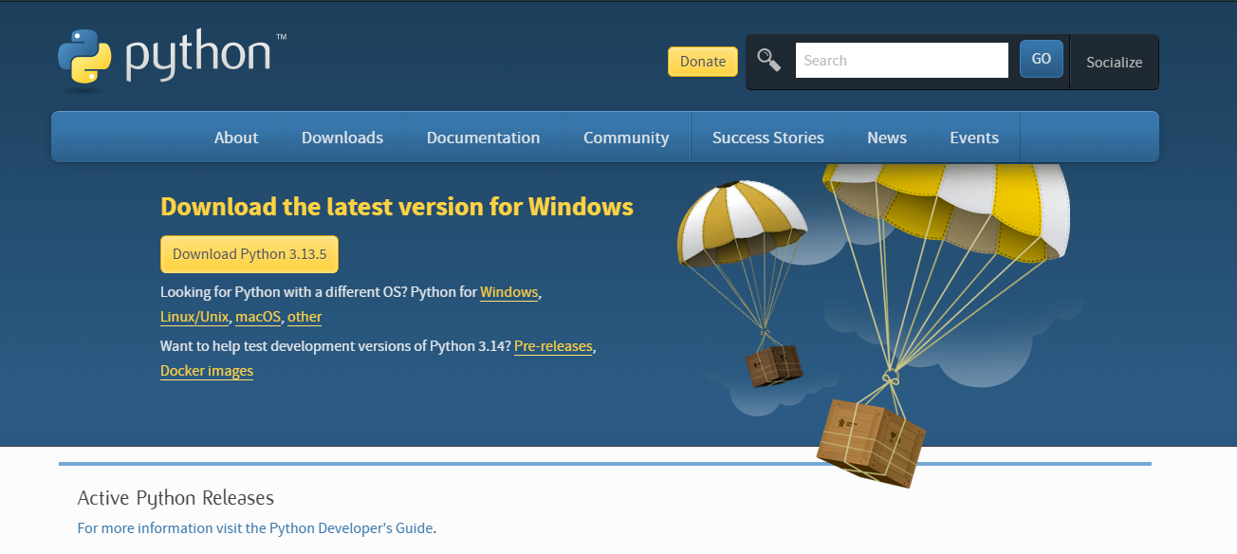
Let’s download Python
If you haven’t already… go to python.org and download the latest release of Python
Notes:
Take 3-5 minutes to let people download Python

Slide 3
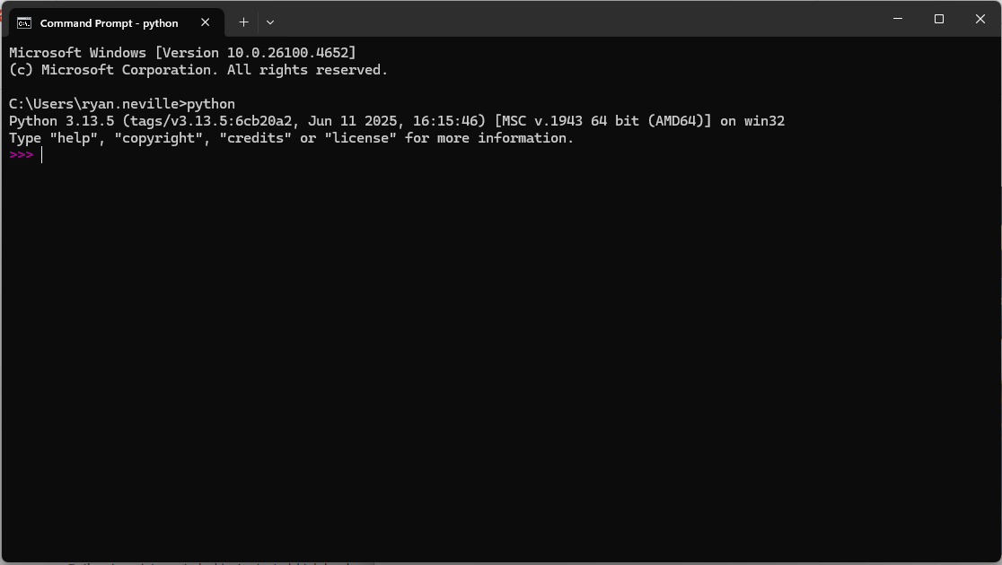
Verify the download
Open a command prompt and type in “python”. Your terminal should indicate it is running Python with the “>>>”
Run a few basic commands.
x = 5
x+2

Slide 4
Interactive Python
Running Python in the terminal like this is great way to interactively see what individual lines of code do but…
Oftentimes we want to run dozens (or hundreds) of lines of code at a time. For this, we want to write python scripts.
It would also be nice if there was software that would help us write and manage code, have useful plugins, be integrated with AI, etc…
We need an Integrated Development Environment (IDE)
Notes:
Give 3-5 minutes for download

Slide 5
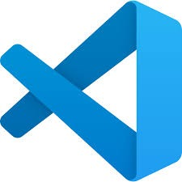

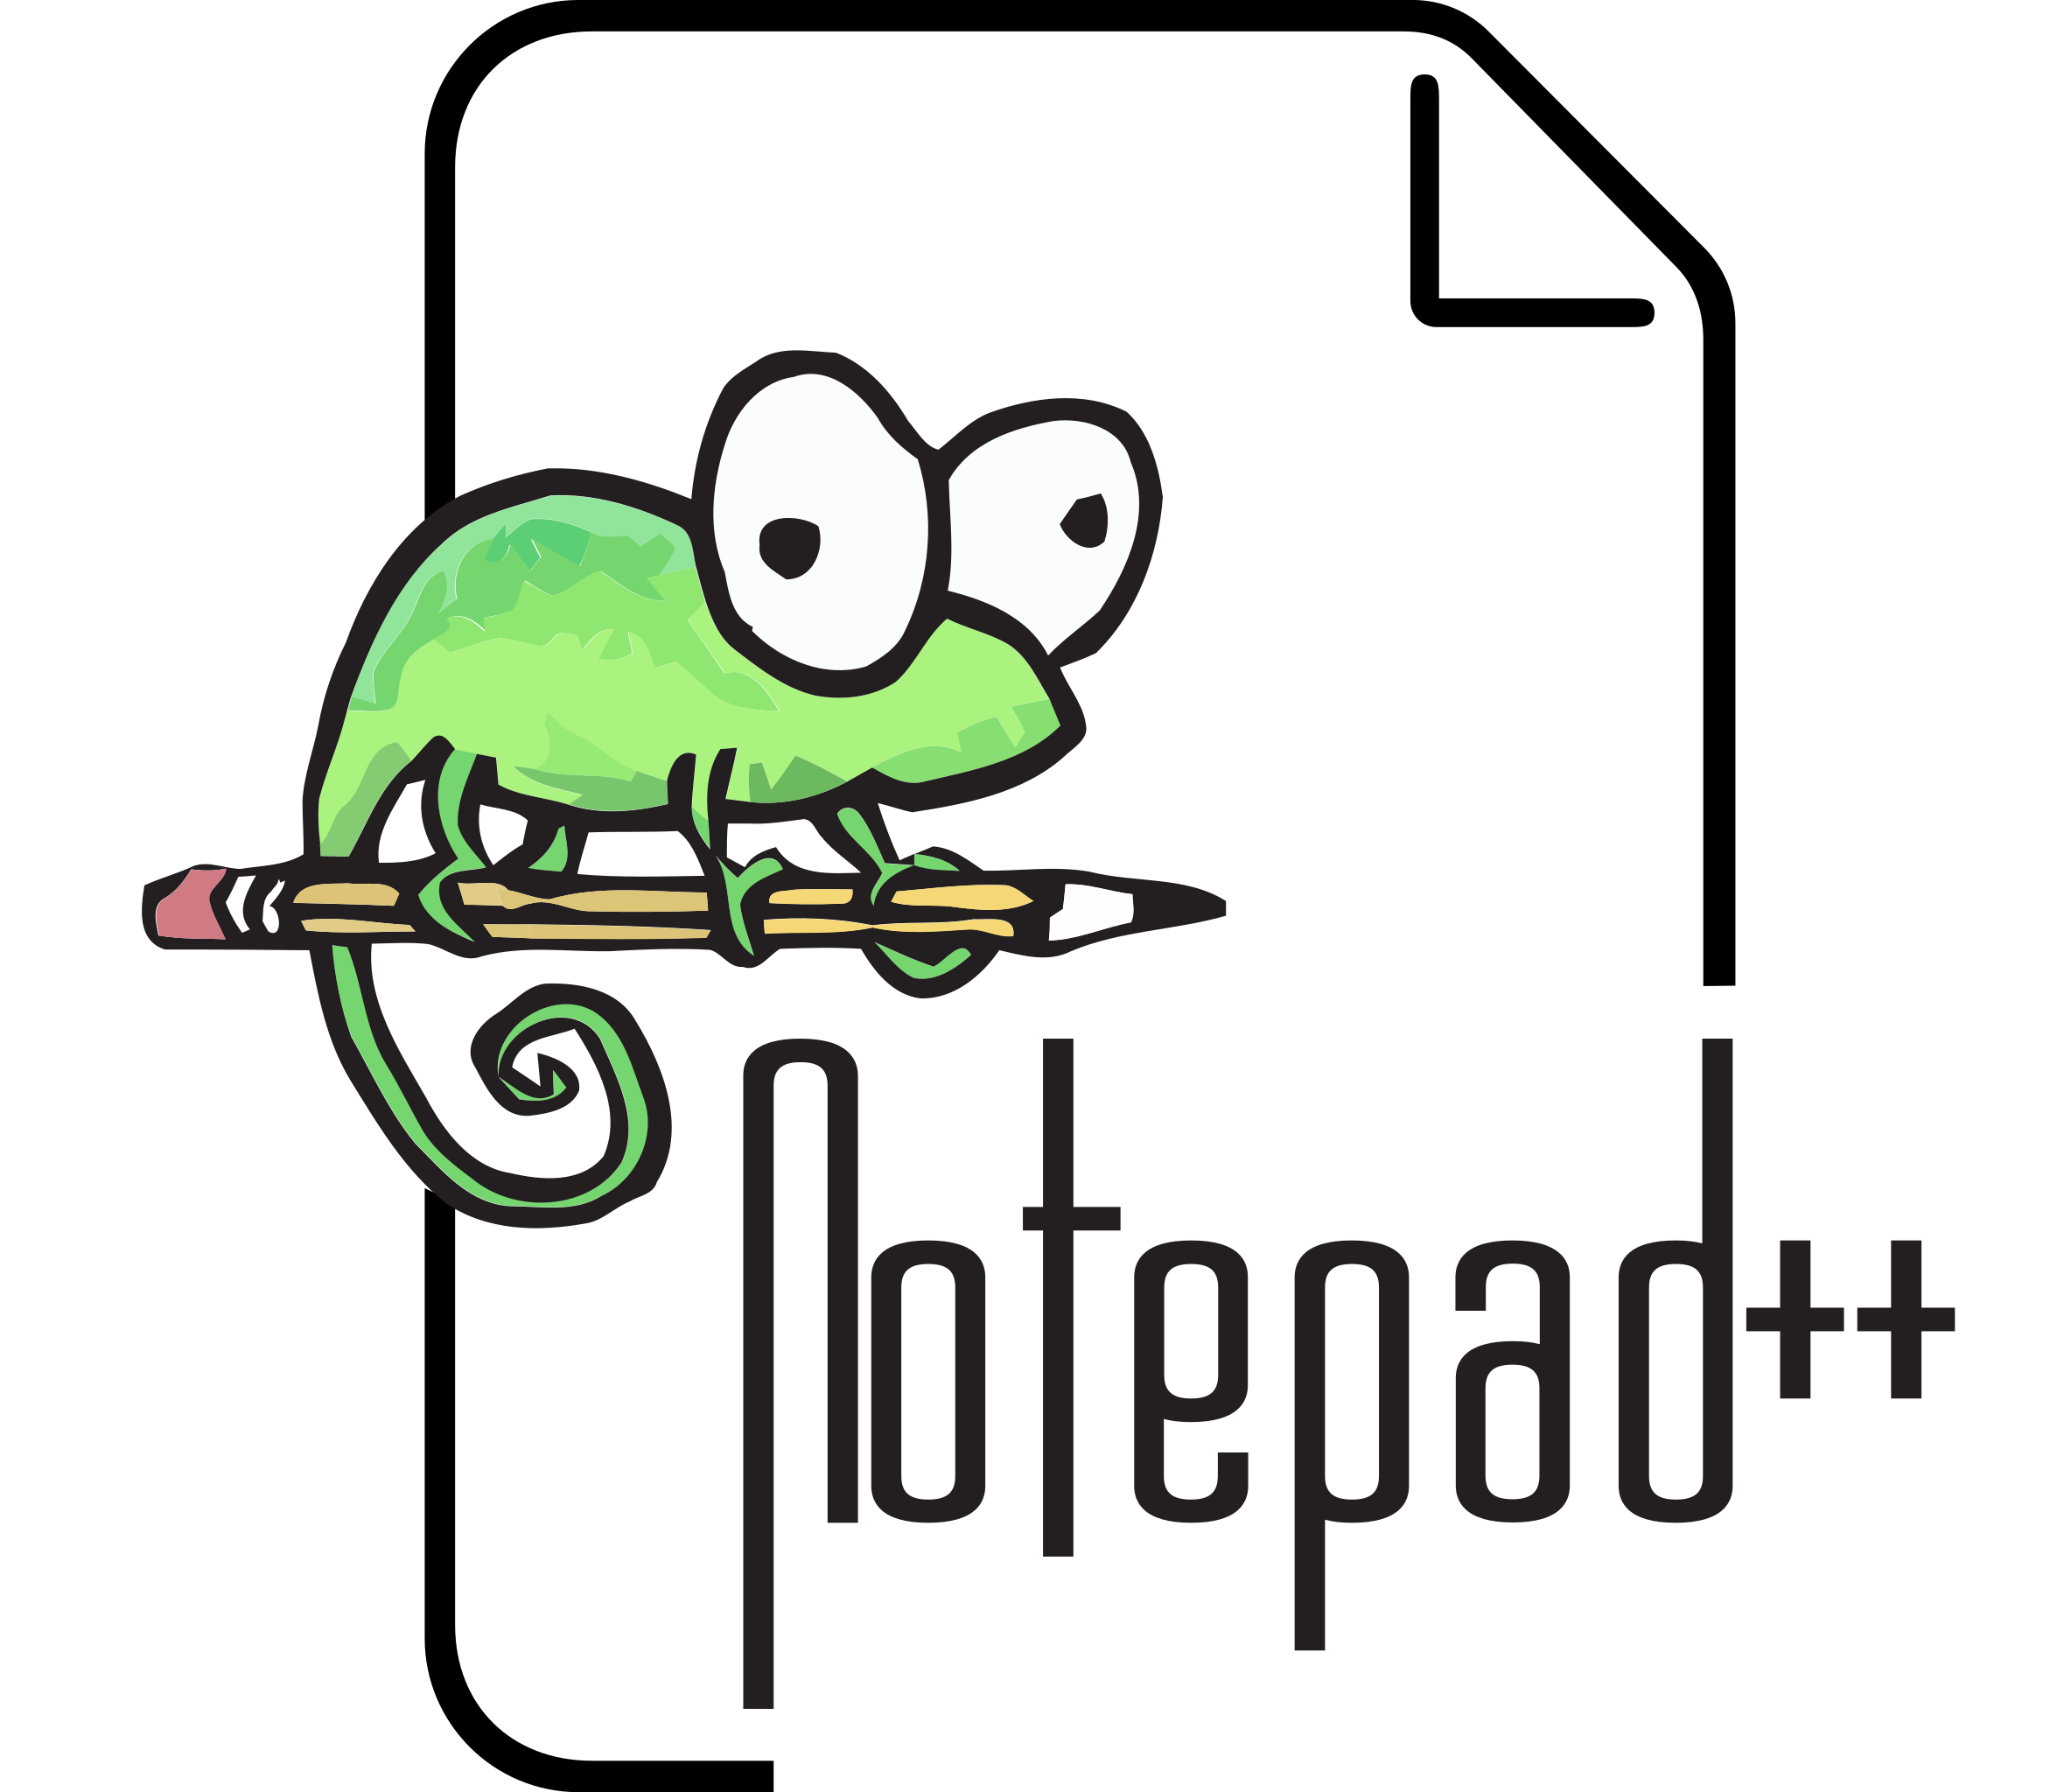
Integrated Development Environments (IDE)
There are many IDEs that can help you write and manage code.
Visual Studio Code
PyCharm
Notepad++

Slide 6
Visual Studio Code
We use VS Code in AI2C, and you will use it for classes at CMU.
VS Code has great version control management built in and many great plug-ins
Take a few minutes to download VS Code

Slide 7
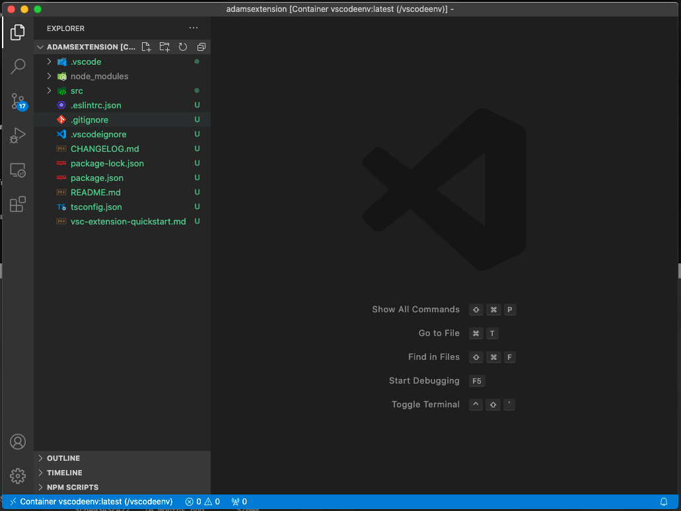
Running code in VS Code
Give a quick tutorial on VS Code:
- File Explorer
- Terminal in VS Code

Slide 8
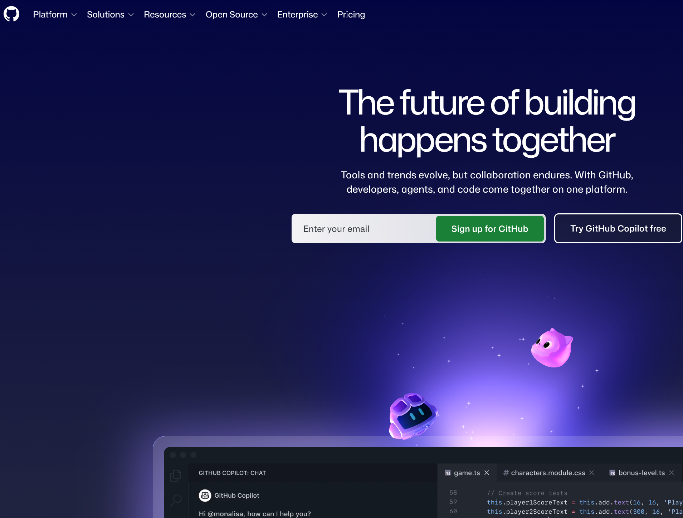
Saving Code on the Internet and version control?
Go to https://github.com and setup a github account.
Also download git at https://git-scm.com.

Slide 9
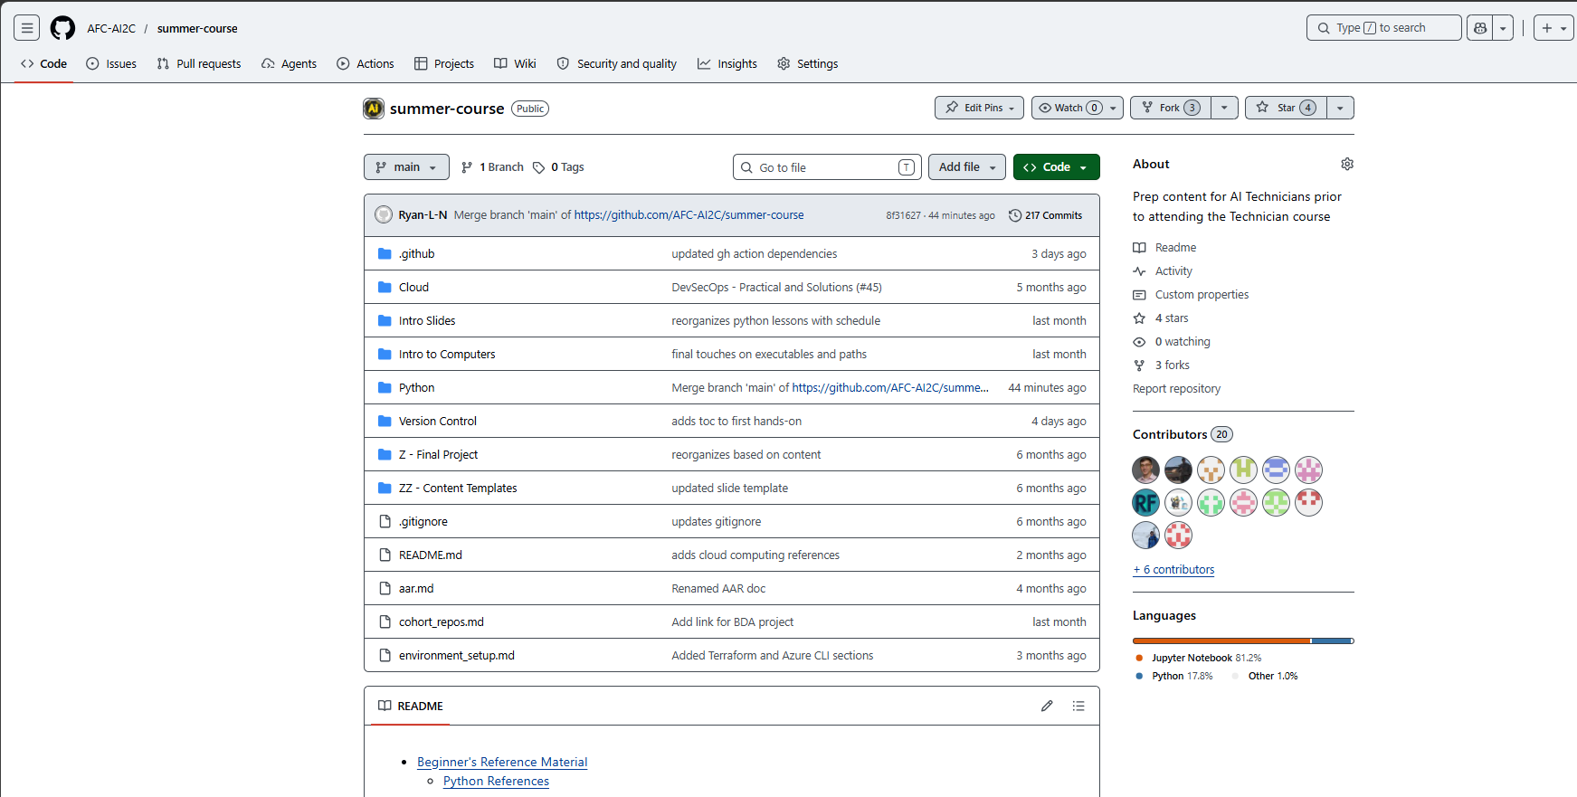
Fork the content for this summer
Go to https://github.com/AFC-AI2C/summer-course

Slide 10
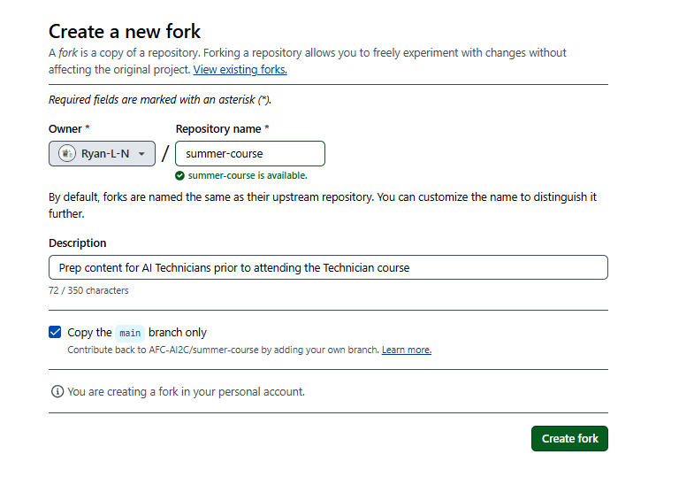
Create a fork

Slide 11
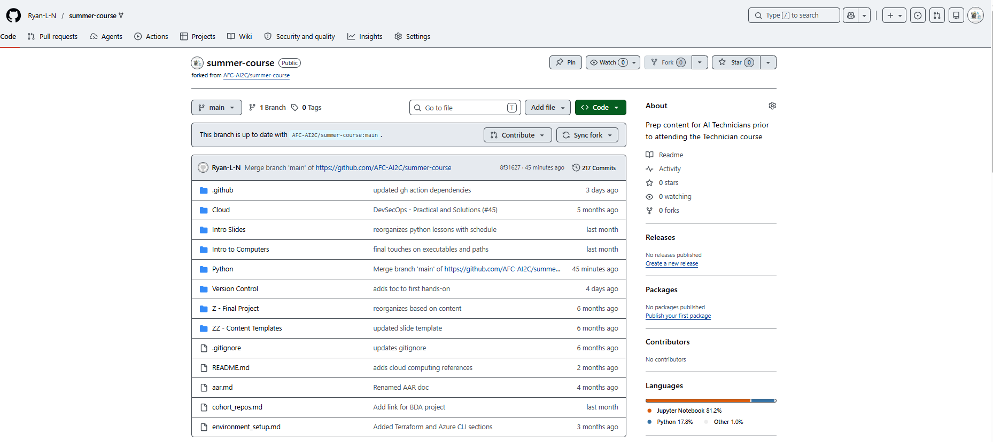
YOUR FORKED REPO!

Slide 12
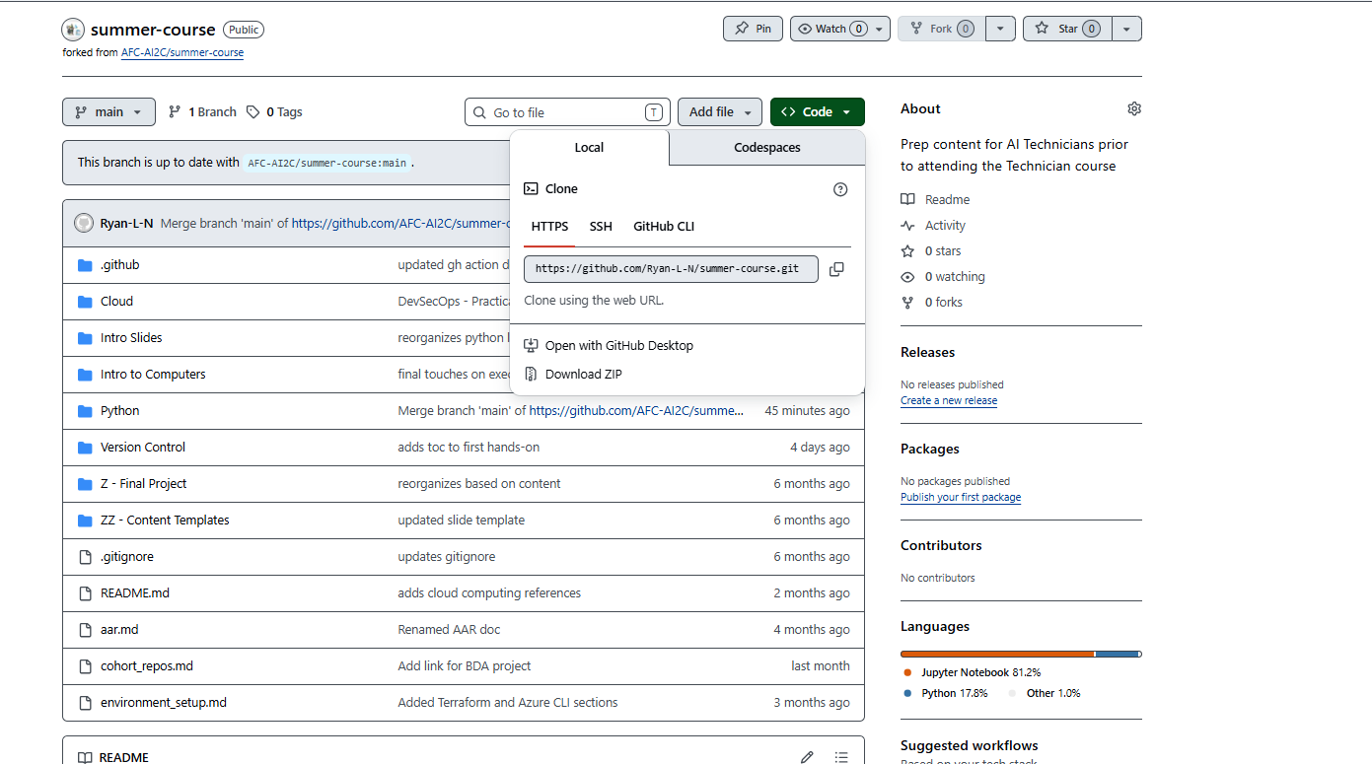
CLONE FOR LOCAL DEVELOPMENT

Slide 13
CLONE FOR LOCAL DEVELOPMENT

Slide 14
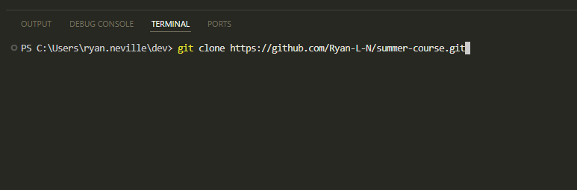
IN VS CODE…

Slide 15
What did we just do…?

Slide 16
Take a 5 minute break

Slide 17
More environment setup
Open enviroment_setup.md
Follow steps to download:
WSL
Docker Desktop
Terraform
Azure CLI
Set up this account:
1) Docker Hub

Slide 18
How to run a python script!

